Slide 1
Microsoft Entra Verified ID
Proof of Concept (PoC)

Slide 2
Version History
hidden slide
Version | Changes | Date
1.0 | Initial Release. | 18th Sept 2024
2.0 | GitHub sample update | 3rd April 2025

Slide 3
Key interactions in need of greater trust
Onboarding Shortcomings
Access Challenges
Help Desk Vulnerabilities
90 thousand
75%
$1.1 billion
Cases of employment-related identity theft in U.S. in 2023
Global population’s personal data under privacy regulation by 2025
Loses to impersonation scams in the U.S. in 2023
2023, FTC Fraud Report
How common is identity theft in 2024? (norton.com)
Gartner 2024 Top Five Trends in Privacy
FTC Data Spotlight into impersonation scams
Notes:
Many key interactions happen online, how do you know you’re dealing with the right person? How widespread is this issue?
Onboarding shortcomings
Must protect organization from candidate impersonation: Bad actors will steal personal information of a qualified candidate and then apply for a job. Hackers can use deepfakes to impersonate someone’s appearance online, such as in remote interviews. Deepfakes considered a top five cybersecurity threat of 2024 by Forrester⁶.
Access challenges
Regulation over data and access is growing: 75% of global population’s personal data will be under privacy regulation by year-end 2024² Imperative to know who has access to your resources and trust them, strict compliance requirements in place for regulated industries and government vendors. Hefty fines and penalties for noncompliance
FinServ: Know your customer (KYC) and anti-money laundering (AML) in the U.S.
Healthcare: patient privacy laws such as HIPPA in the U.S
Edu: student privacy protection laws such as FERPA in the U.S.
GDPR in Europe
Example: Access to resources without verification creates risks: In 2023, an attacker got into T-Mobile through a single improperly secured API. Result was a data breach that affected approx. 37M customer accounts^{3,4}. Likely could have been avoided if they had proper ID verification before granting access
Help desk vulnerabilities
impersonators often get in by posing as employees, calling the help desk, and getting their device registered to the employee’s account. They don’t need to steal an identity, they could convince an IT worker to let them in. In U.S. in 2023, over $1.1B loses to impersonation scams of all types and 330K+ reports of business impersonation scams⁸. 35% of business in the UK experienced an impersonation attack over the last 12 months^{9.}
Example: Happened to MGM in 2023, impersonator had a 10 min call with the help desk, was given access to MGM internal systems, and did damage forced MGM to shut down all systems and lost 100M in total^{7,10}
TRANSITION: How can we add trust to these interactions so that your organization knows who is on the other side of the screen?
Extra datapoints to share if you want
--------------------------------------------------------------------------------------------
¹ ***lots of stats to look at from the source: https://www.g2.com/articles/onboarding-statistics***
88% of workers think their company’s onboarding has room for improvement (12% think their company’s onboarding is satisfactory)
Great onboarding can improve retention by 82% and work quality by over 70%
Onboarding is biggest challenge for 37.4% of HR professionals
47% of businesses face difficulties in onboarding due to problems with accessing infrastructure.
22% employee turnover without efficient onboarding within the first 45 days of employment.
Hackers are getting smarter with impersonation and social engineering
Evolved phishing considered top threat for CIOs by Gartner⁵: Phishing leads to credential theft/impersonation and is a top contributor to data loss
Credential abuse: attackers impersonate someone with legitimate access, can sometimes defeat MFA which is a best practice for authentication
The rise of deepfakes and other gen-AI impersonation tactics creates new security vulnerabilities that are growing in frequency.
Sources
¹50+ Employee Onboarding Statistics You Must Know in 2024 (g2.com): https://www.g2.com/articles/onboarding-statistics
²Gartner 2024 Top Five Trends in Privacy: https://www.gartner.com/en/newsroom/press-releases/2022-05-31-gartner-identifies-top-five-trends-in-privacy-through-2024
³T-Mobile Informing Impacted Customers about Unauthorized Activity - T-Mobile Newsroom: https://www.t-mobile.com/news/business/customer-information
⁴T-Mobile breached by hackers as 37 million customers impacted - ABC News (go.com): https://abcnews.go.com/US/mobile-breached-hackers-37-million-customers-impacted/story?id=96557559
⁵Comprehensive Protection Strategies Against Cyber Threats | Gartner: Comprehensive Protection Strategies Against Cyber Threats | Gartner
⁶Forrester State of Cybersecurity Innovations: https://www.forrester.com/blogs/state-of-cybersecurity-innovation-rsa-conference-2024/#:~:text=Forrester%20calls%20out%20deepfakes%20as%20one%20of%20the,and%20brand%20damage%2C%20amplification%20of%20misinformation%2C%20and%20more.
⁷Inside The Ransomware Attack That Shut Down MGM Resorts (forbes.com): https://www.forbes.com/sites/suzannerowankelleher/2023/09/13/ransomware-attack-mgm-resorts/
⁸Federal Trade Commission Research: https://www.ftc.gov/business-guidance/blog/2024/04/new-ftc-data-spotlight-offers-illuminating-insights-impersonation-scams
⁹uk.gov research: https://www.gov.uk/government/statistics/cyber-security-breaches-survey-2024/cyber-security-breaches-survey-2024
¹⁰MGM loses $100M, refused to pay ransom to end cyberattack (nypost.com) MGM loses $100M, refused to pay ransom to end cyberattack (nypost.com)

Slide 4
Introduce trust & efficiency with Microsoft Entra Verified ID
Ensure identity and qualifications of new hires then onboard in minutes
Easily grant access and elevate permissions for trusted users to improve compliance
Quickly verify employment to protect and simplify help desk & recovery processes
Trustworthy remote
onboarding
Secure access to resources
Help Desk & Account Recovery
Notes:
How can Microsoft help you address these issues?
Introduce Verified ID in these processes to improve trust & efficiency. Microsoft Entra Verified ID is a managed verifiable credential service that lets organizations build unique user-owned identity scenarios designed for trustworthy, secure, and efficient interactions between people and organizations.
Onboarding
Check on the identity and skills of who you’re onboarding so that you are certain of who you are onboarding. Not only can you improve trust but also efficiency. Onboard workers securely in minutes, not days or weeks. Eliminate the tedious manual tasks and waiting that make onboarding such a pain. Make onboarding a simple task that can be done in minutes from someone’s device
Access to resources
Prepare your organization to handle privacy regulations by allowing sensitive data and resource access only to trusted users that fit specific criteria
Help desk/account recovery
Cut off this impersonation avenue, while limiting long IT calls. Make the help desk simple to access for trusted users, while blocking everyone else
Can watch VID webinars that touch all these use cases and go into setup at aka.ms/VerifiedIDwebinars

Slide 5
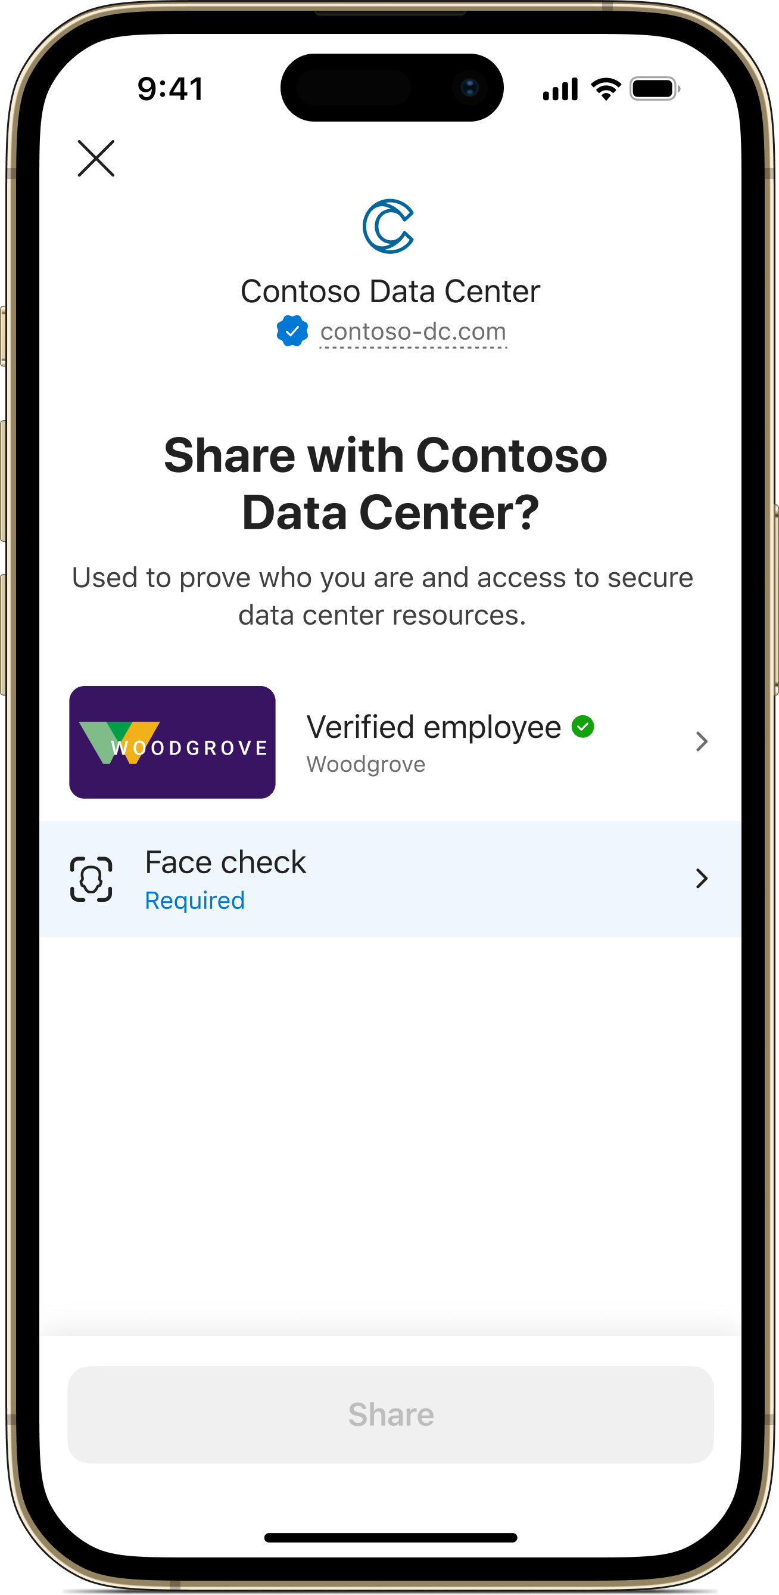
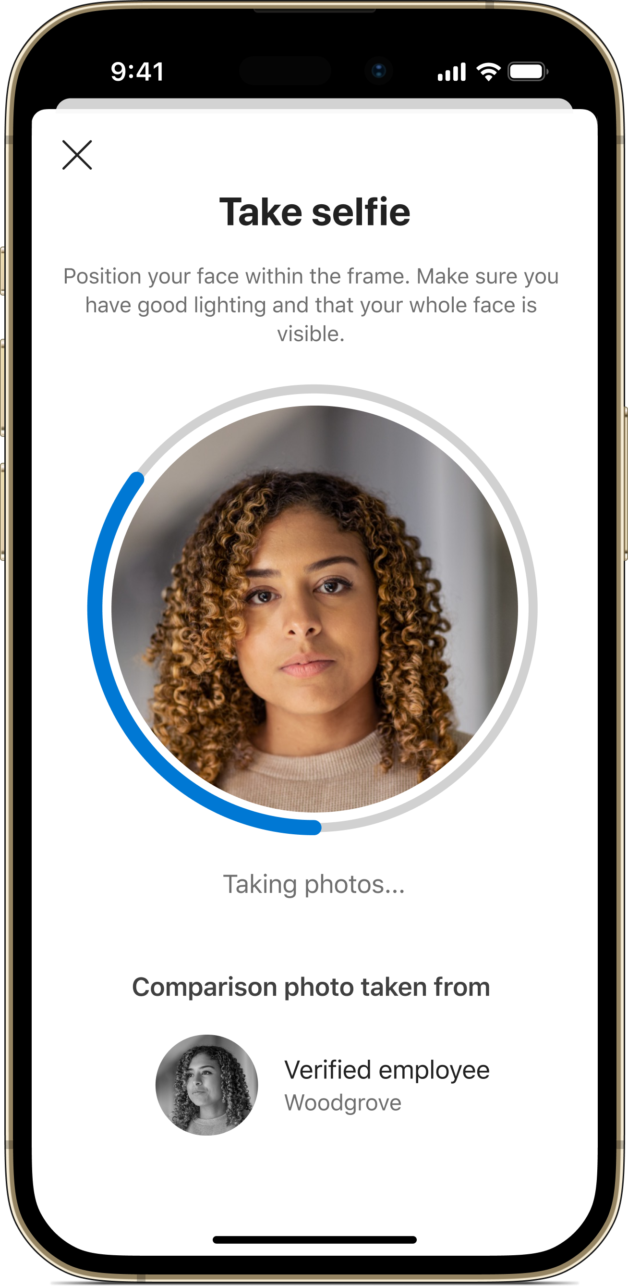
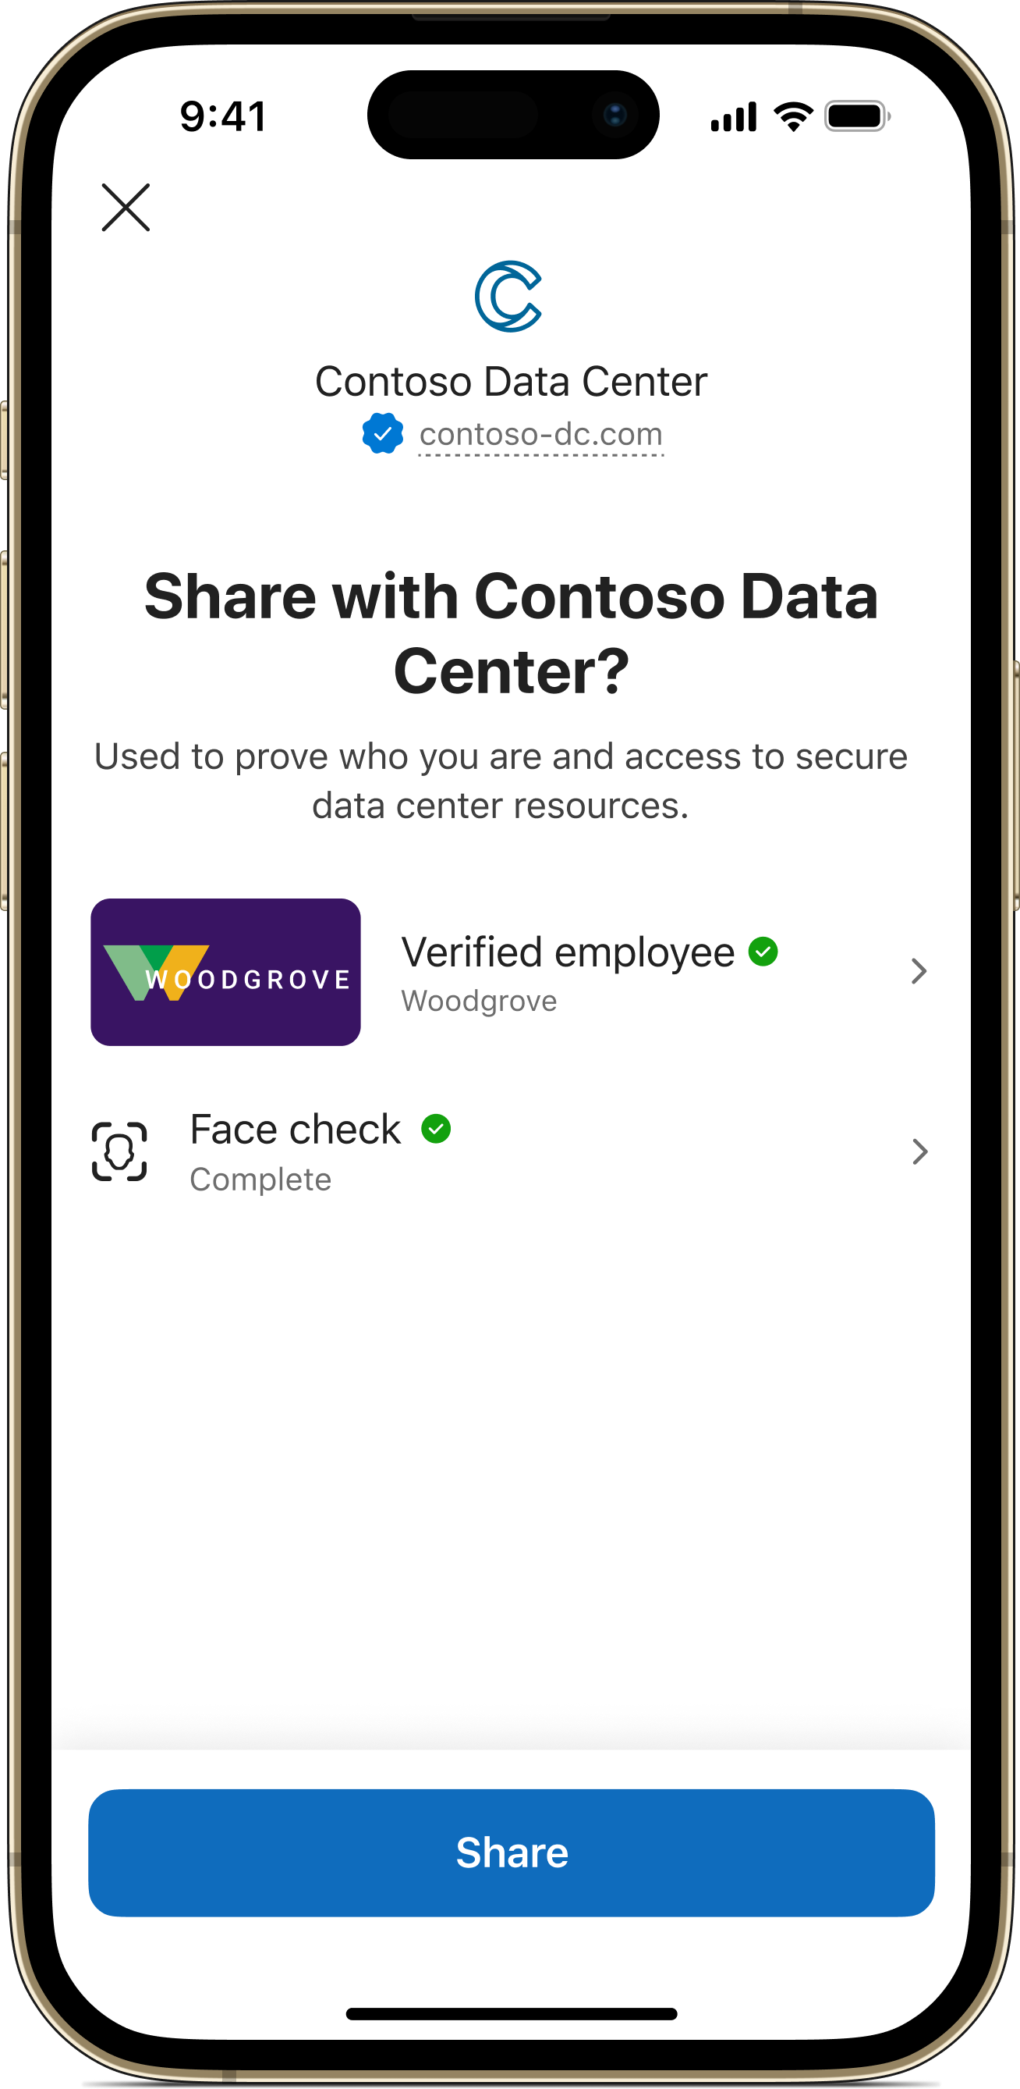
Grant access to only the right people with Face Check
High-assurance verification at scale
Build on trust established with Verified ID with an added layer of identity verification
Verify liveness in an instant
Make sure the right person is using a Verified ID in real time
Facial matching in any scenario
High assurance for onboarding, account recovery, or any Verified ID scenario
Present Verified ID and start Face Check
Take selfie for Face Check
Share valid Verified ID and Face Check for verification
Notes:
Face Check with Microsoft Entra Verified ID introduces privacy-respecting facial matching into your identity verification processes. Use it to be certain that you know who is on the other side of a digital interaction when they present a Verified ID.
Face Check is a premium add on that you can implement on top of Verified ID for an additional verification layer of liveness. Know who is presenting a Verified ID in the moment it is presented. All it takes is a quick selfie.
Face Check can be added to any Verified ID scenario. Stop impersonators from onboarding to your company, accessing your sensitive resources and apps, and from using the help desk as an entrance into your organization.
How does Face Check with Microsoft Entra Verified ID work? (left side of screen)
Users own Verified IDs, which contain information about their identity such as their name, age, employment status, nationality or any other identity. The Verified ID can store a picture, usually one that comes from a trusted document such as a passport, driver’s license, or employee credential.
Face Check compares an individual’s live selfie with the photo that is stored on their Verified ID.
Face Check is privacy-respecting, it does not pass or store any personal information after completing the Face Check. The live selfie is discarded, and the verifying organization only receives a confidence score that shows how closely the live selfie and stored Verified ID photo resemble each other. Verifiers set a threshold confidence score that they will deem as a valid score. Default is 75%
Examples where you may want Face Check in addition to Verified ID:
For a basic help desk function, just Verified ID is likely enough. If an employee wants to reset their password or recover their account, those are more sensitive actions where you might want to be more certain about who is taking the action. Use Face Check to ensure that the rightful user is taking this action and that an impersonator isn’t going to lock them out by changing a password
If a banking customer is making an unusually large transaction, you may want to make sure the right person is spending that much money
In academia, a university could want to make sure that the right student is about to take an online exam
Use Face Check for an action in need of higher assurance that you’re dealing with the right person
TRANSITION: Let’s see an example

Slide 6


Entra Verified ID scenarios for Proof of Concept (POC)
Assign employee access to resources (new or move scenario)
Entitlement Management
Verified ID
Secure onboarding for guests/contractors and resource access
Entitlement Management
Verified ID
Secure privileged access (verify privileged users)
Entitlement Management
Verified ID
Helpdesk and account recovery
Verified ID
GitHub sample
Private Access
Streamline Employee onboarding (clickthrough)
On-premises access to RDP Session(Private access)
Enhanced guest user lifecycle (clickthrough)

Slide 7

How to deliver a POC
Ensure customer has the baseline understanding
Deliver the L100 deck to explain what Entra Verified ID is and its capabilities?
Discuss the possible scenarios, understand their ask and pick “1” from the POC scenario list
Customers will have varied asks and expectations, POC is about showcasing the value so pick the scenario that closely aligns to their ask to show product capability
Storyboard
Engaging stakeholder from the start is important so work with them to define the storyboard. Refer example storyboard for inspiration.
Define “Success Criteria”
Once the scenario has been picked, agree with the customer to define the conditions of satisfaction. Refer appendix slide.
Alignment for next steps
Discuss a high-level next step post the PoC at the start and then detail the next steps as the POC is about to close.
Customer could use their team or work with one of Services Partners to take the scenario to production https://aka.ms/verifiedidservicespartners
Notes:
By keeping these 5 key points in mind, you can ensure that your POC delivers meaningful results and insights. By setting the right expectations, tailoring your POC to the customer's unique needs, engaging stakeholders throughout the project, defining success criteria and goals, and ensuring that the customer has the right knowledge, you can deliver a successful POC that meets your customer's needs and drives business value.

Slide 8
Microsoft Entra Verified ID workshop and PoC engagement
Pre-
engagement
L100 Workshop Delivery
Testing and reporting session
PoC engagement closure
PoC
0.5 hour
Introductions
Engagement walk-through
Expectations
What’s next
Customer’s agreement?
YES - Pre-engagement preparations like sharing the agenda, identifying the stakeholders
NO - We need your feedback – WHY?
2 hour
Microsoft Entra Verified ID Overview
Discovery of customer’s use case and how this solution will help
Drafting the storyboard for POC
Discussion on PoC next steps and pre-requisites
1 hour
Pre-requisites review
Quick Config onboarding
Deploying Verifier scenario
Test users onboarding and targeting for test use cases
1 hour
Walk through test cases and user journey
Agreement on next steps
0.5 hour
PoC review, closure and sign-off
Consult if customer would like to be highlighted as a reference in Microsoft’s public marketing platforms
Agreement on next steps kick off date
2 hours or less

Slide 9
PoC | Timeline
1. Prerequisites
2. Initial
Configuration
3. Configure Issuer and Verifier
4. Test issuance
5. Test Verification
~10-20 min
~1 hour
~10min
30 min
2 hours or less
Entra ID tenant with custom domain for Quick setup (preferred)
Entra ID tenant and other perquisites for Advanced setup
Azure subscription for Appservice
Admin roles for Entra Verified ID, KeyVault and Appservice deployment

Slide 10
PoC Scope
Enable customer’s tenant with Microsoft Entra Verified ID Quick Setup. Note: In case the customer prefers Advanced Setup OR they are already onboarded with manual config then move to step2.
01
Scope VerifiedEmployee issuance to a target group using My Account.
OR
Custom credentials like IDV credentials
02
Enable Entitlement Management + Verified ID integration.
(POC scenarios with Entitlement Management and Verified ID)
03
OPTIONAL:
Deploy GitHub sample6 for helpdesk
https://aka.ms/verifiedhelpdesk
04

Slide 11
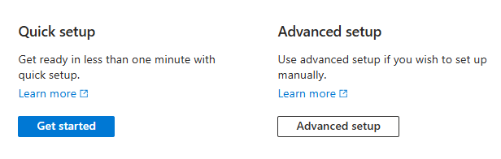
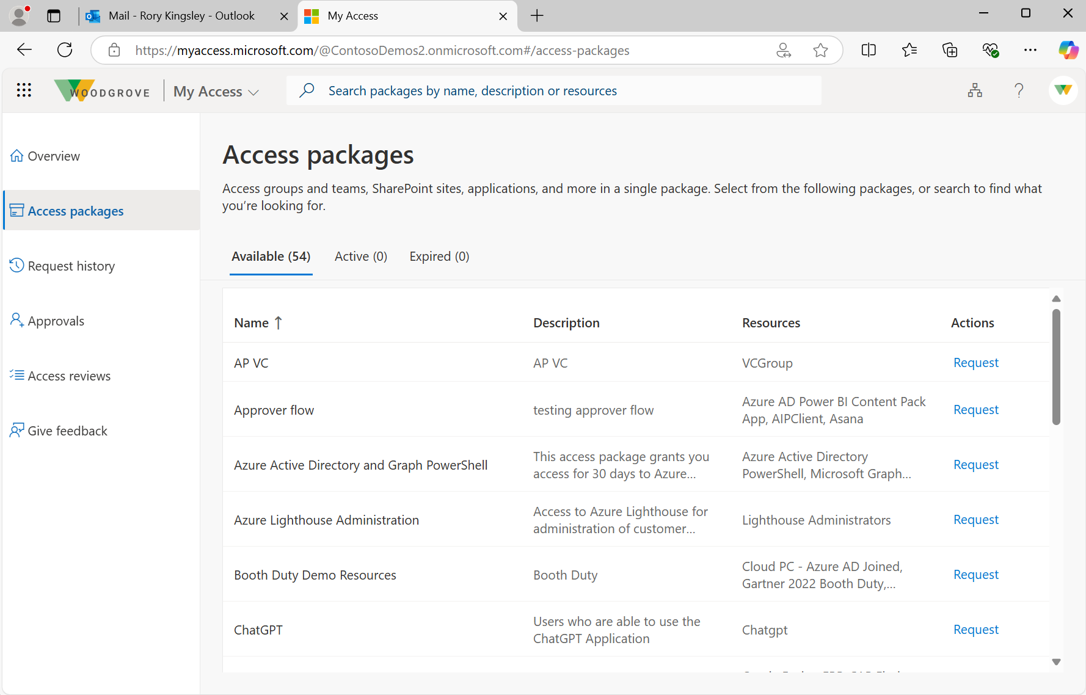
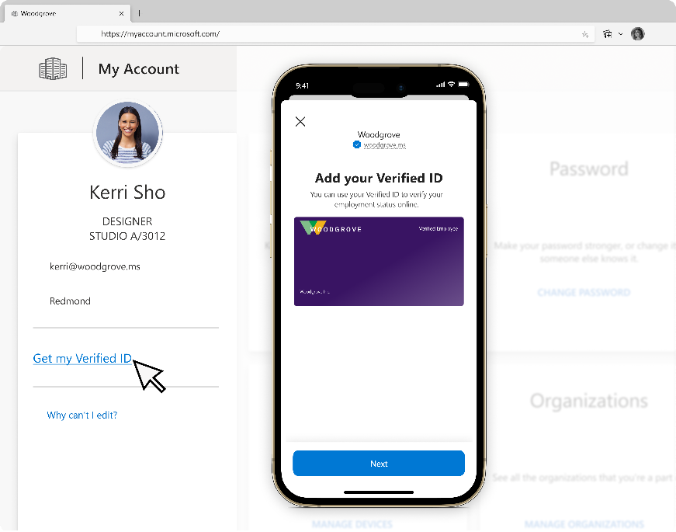
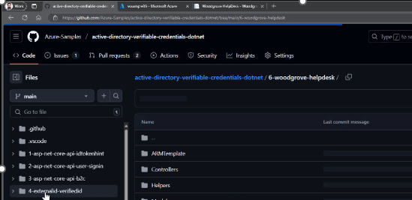


Building blocks
1. Admin sets up Verified ID
2. User obtains credential
3. Admin sets up scenario
Choose quick or advanced setup
Configure default employee or custom credential
OR
Option 1: Employee ID from myaccount.microsoft.com
Option 2: Gov ID from trusted authority
Deploy and configure
Notes:
Custom credential
User claims from door management system
HR system
Self-registration OR
IDV partner issued

Slide 12
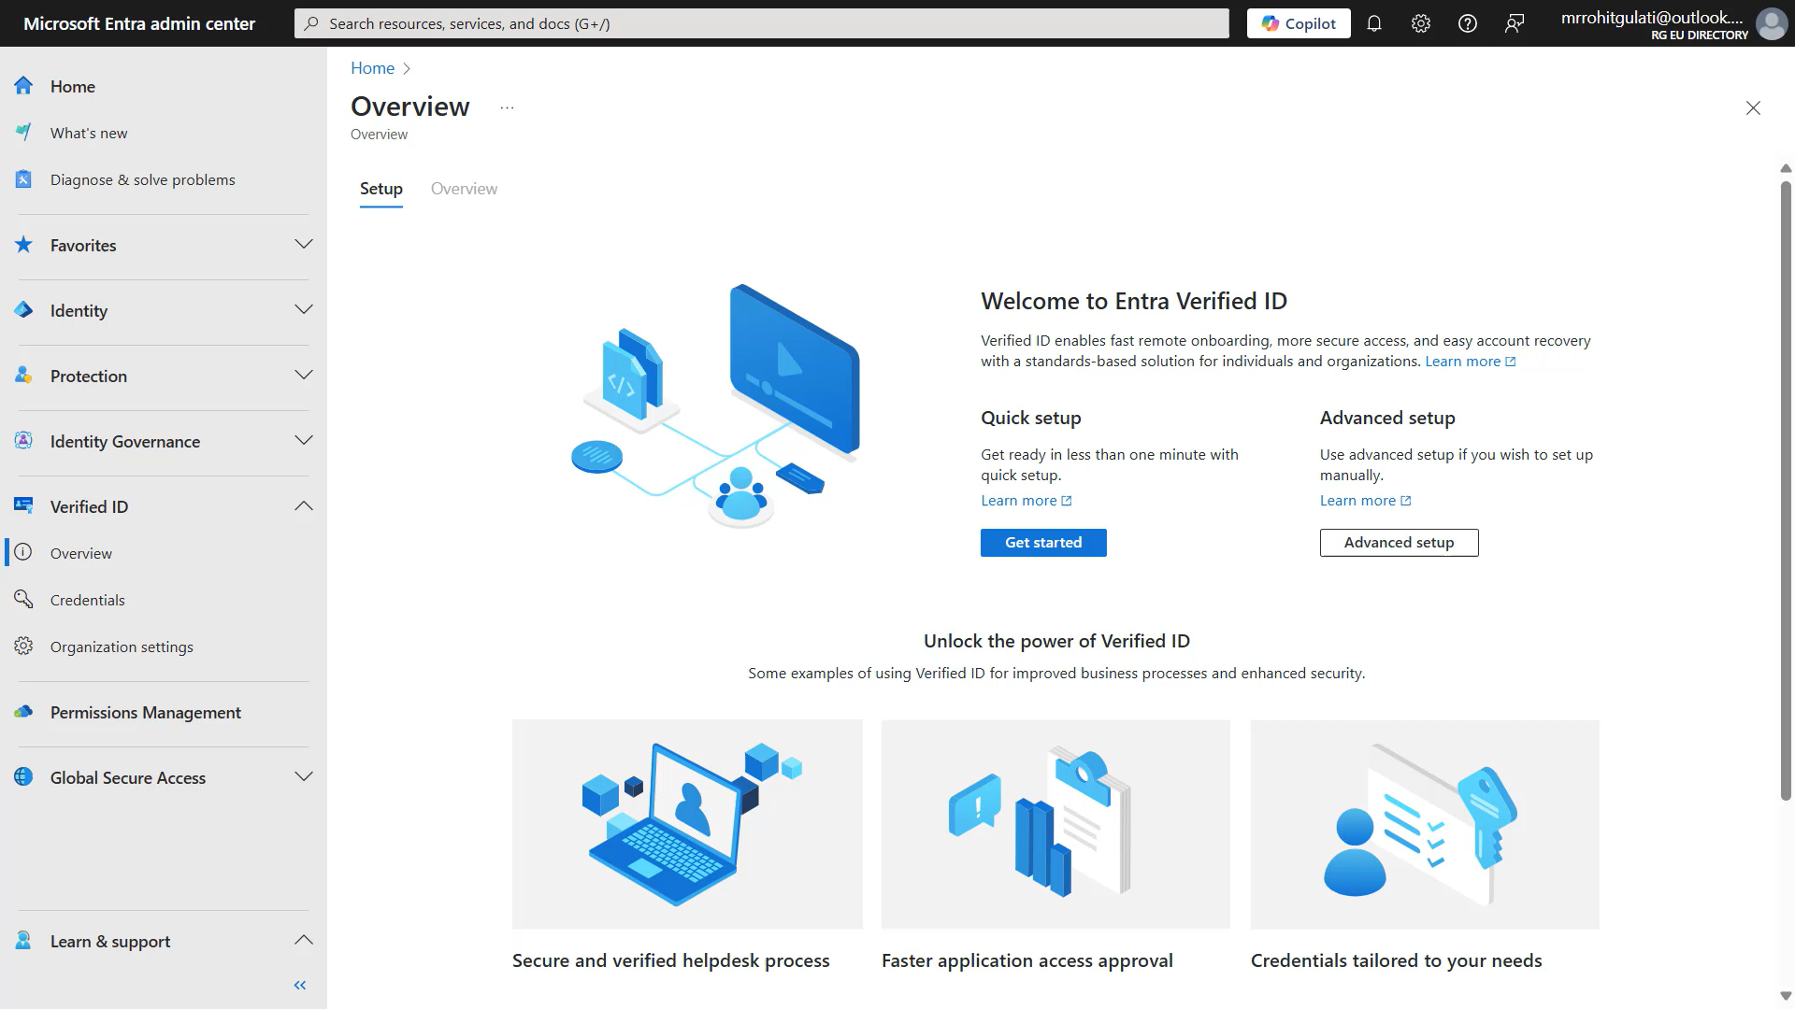
Quick Setup

Slide 13
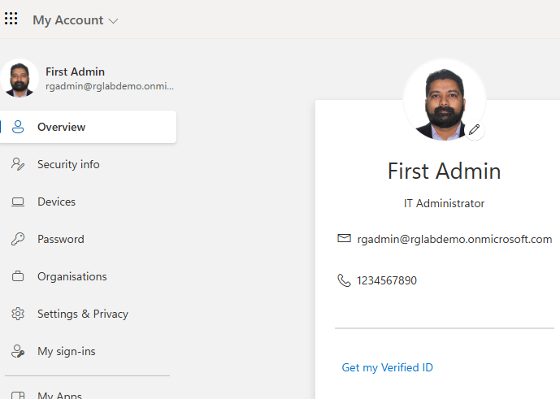
IT Helpdesk enabling Verified ID issuance for employees
Initiating Verified ID Process
Self-service.ithelpdesk.com
To
From
Subject
Rohit Gulati
IT Helpdesk
Verified ID onboarding
Welcome to IT helpdesk - Onboarding Portal
1
Install Authenticator
Please help us get more secure. Please navigate to our onboarding portal with instructions how to setup your personal phone and help your organization to be more secure.
VerifiedEmployee
Customer1 Employee
Issued by Customer1
Helpdesk Portal
2
Get your Verified Employee Credential
Share
Email campaign
User signed into Onboarding portal
Issue Verified Employee VC (claims from Entra ID) and accept

Slide 14
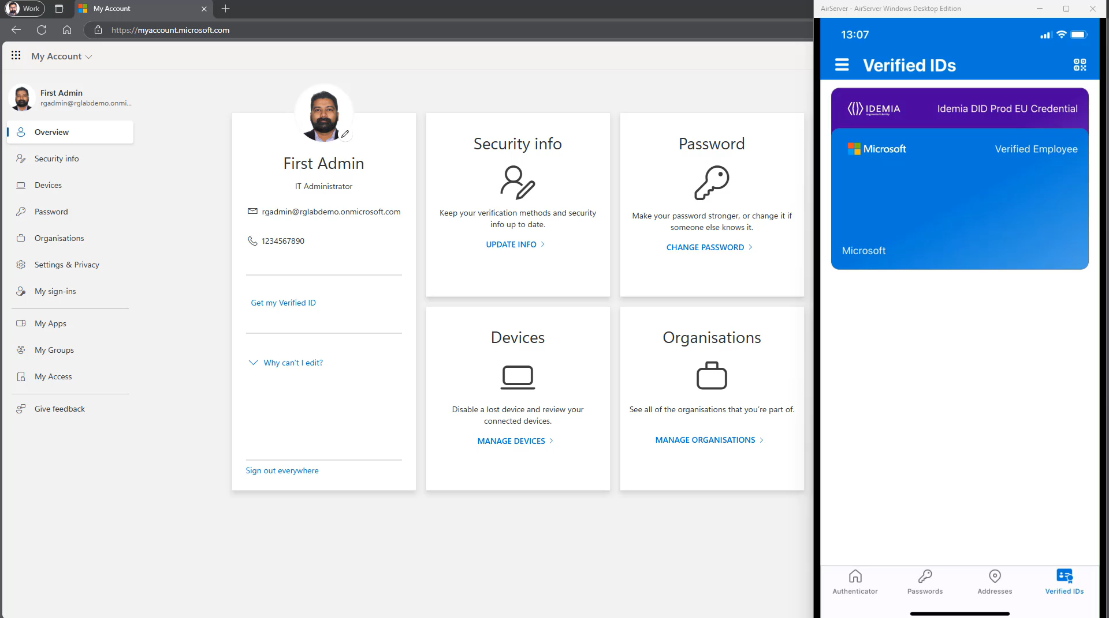
Getting Employee Credential

Slide 15
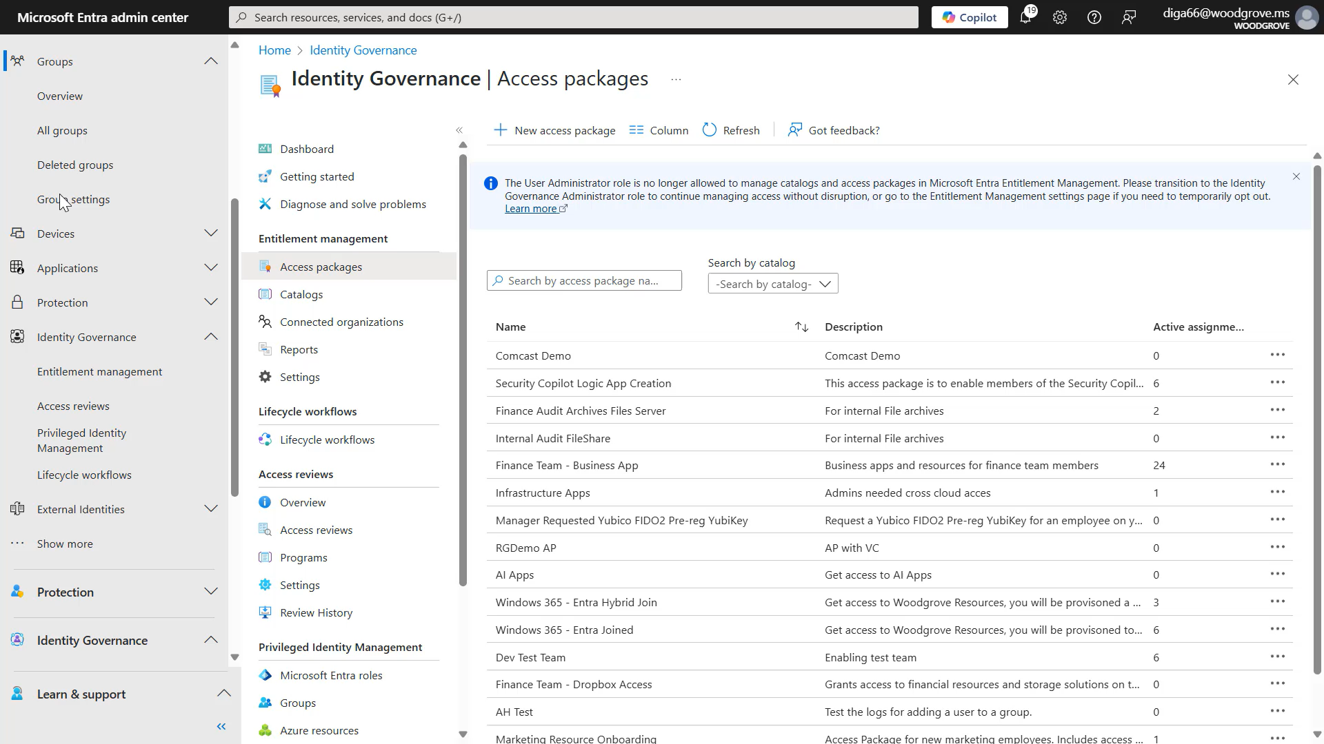

Slide 16

User flow: Verified help desk & account recovery
Notes:
Let’s look at the storyboard

Slide 17
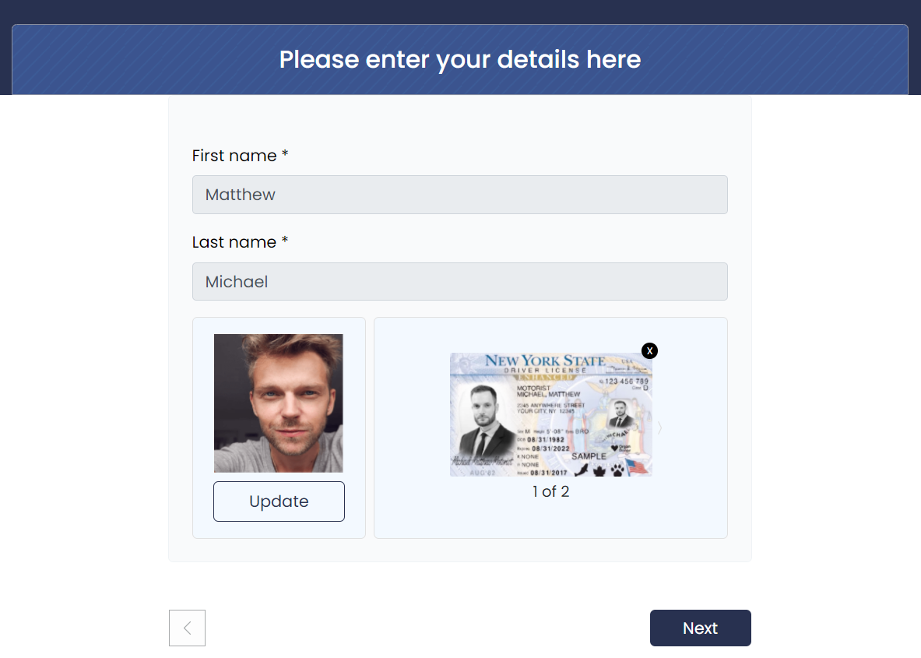

IT Helpdesk enabling Verified ID issuance for employees
Identity Verification flow
Self-service.ithelpdesk.com
Self-service.ithelpdesk.com/identityverification
Welcome to IT helpdesk Onboarding Portal
Authenticator
1
Install Authenticator
Verified Identity
Customer1 Employee
Issued by IDV Partner
2
Get your Verified Employee Credential
3
Get Verified by an Identity Verification Partner
Add card
IT wants high assurance with latest user photo, then use “Identity Verification partner flow”
Get ID Verified on IDV partner SaaS portal
Accept IDV Partner card in Authenticator

Slide 18
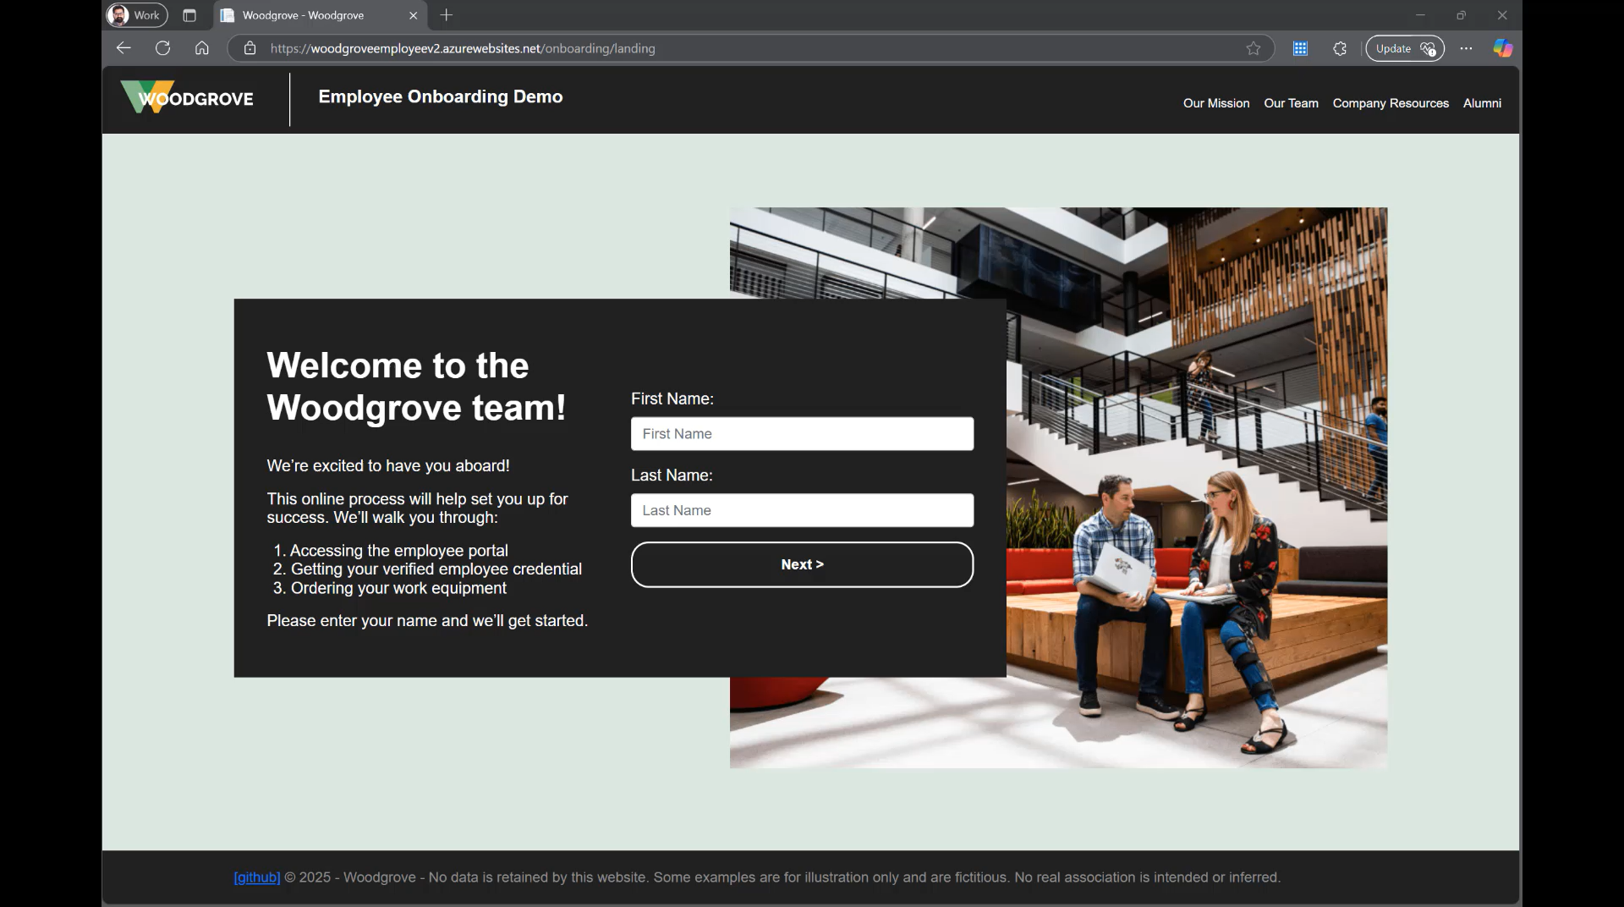

Slide 19
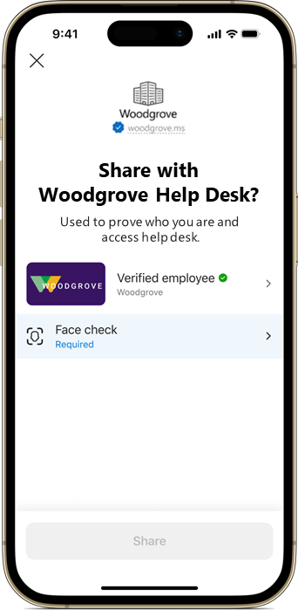
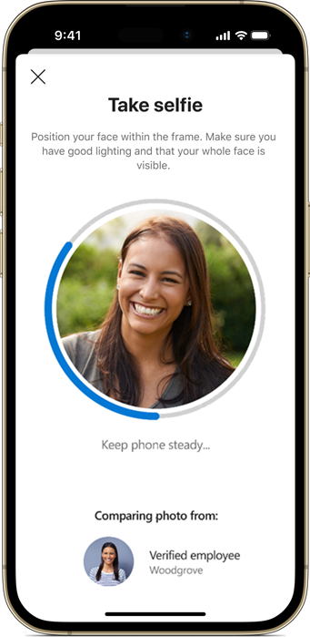
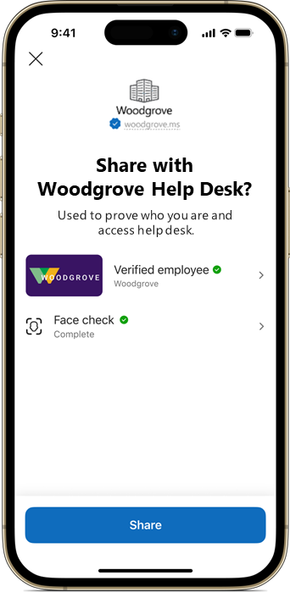
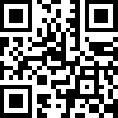
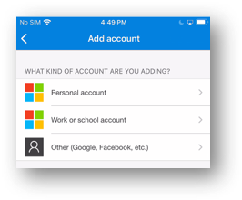
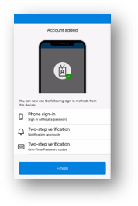
Employee uses IT Helpdesk web portal – say for MFA Onboarding
Self-service. ithelpdesk.com/helpme
Welcome to Helpdesk Portal
VerifiedEmployee
Customer1 Employee
Issued by Customer1
VerifiedEmployee
Customer1 Employee
Issued by Customer1
Get Support
OR
Verified Identity
IDV Partner
Issued by IDV Partner
Share
Share
Employee of Contoso reaching out to IT portal
Employee prompted to take a selfie and submit it along with Verified ID
Verify the identity of the person requesting help
Self-service. ithelpdesk.com/welcome
This entire flow can be customized and managed by the partner/customer IT team. GitHub sample is available at https://aka.ms/vcsample
Verification completed, for “Anna Michael”
Proof your identity
Name – “Anna Michael”
Email – “anna@contoso.com”
Here are some instructions how to setup MFA on your phone….
Upon verification: empower self-service MFA Onboarding steps generated (or any other process that requires higher assurance)
Finish MFA setup

Slide 20
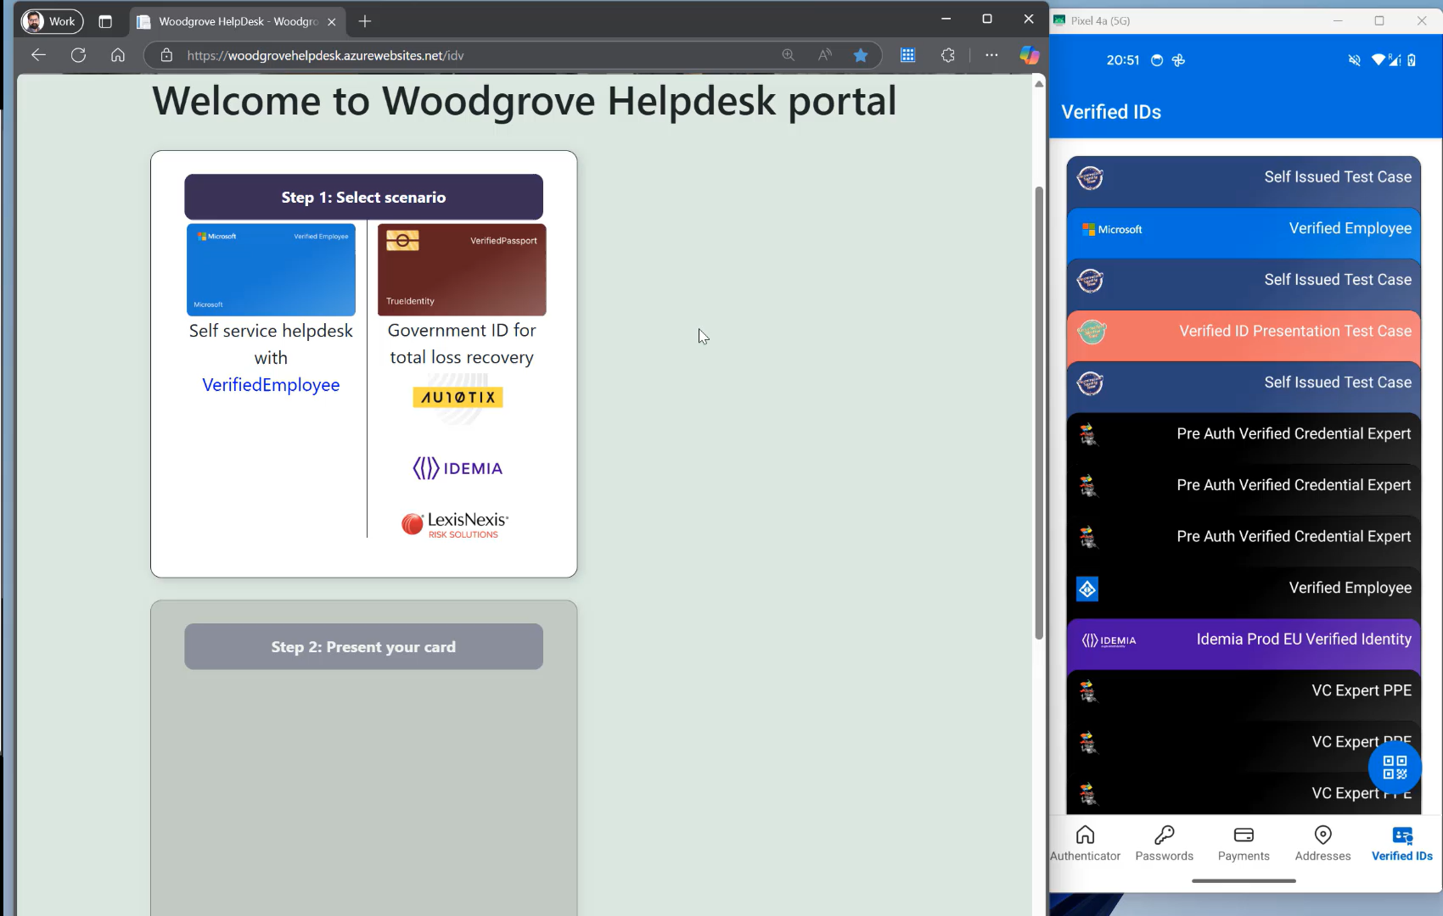

Slide 21
Set up and deploy: Verified help desk & account recovery
Notes:
Let’s look at the storyboard

Slide 22
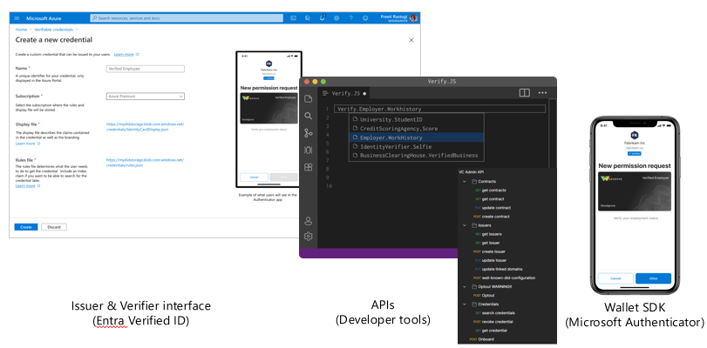
Microsoft Entra Verified ID APIs
Request APIs (Client API) for issue and verify functions
Admin APIs to perform admin functions and add such functions to your own custom build control panels
Onboard
Credential contracts
Credential
Open-source library to integrate into branded app
Issuer & Verifier interface
APIs
(Dev Tools)
Wallet SDK
(MS Authenticator)
Microsoft Entra Wallet Library
aka.ms/VerifiedIDdocs

Slide 23
Request Service API model
REST API
Requires authentication from your Entra tenant
Your app needs and access token with permission to call APIs
Your callback endpoints must be reachable from Azure Cloud platform
Entra tenant
1. Acquire access token
Your App
Verified ID Request Service API
2. Request
3. request_uri
3. Callbacks

Slide 24
Sequence Flow – Helpdesk Verifier with FaceCheck
User
Authenticator
Verifier
(ITSM /Ticketing tool)
Entra Verified ID
1. User visits website and initiates the helpdesk request
by clicking a button
2. Create presentation request
(Require VID, Require FaceCheck)
3. Create presentation & Generate QR Code
4. Response with QR Code
User scans QR in Authenticator
5. Requests for VID (VerifiedEmployee OR IdentityVerificationPartner VC) + FaceCheck (selfie)
6. Presents VID (VerifiedEmployee OR IdentityVerificationPartner VC) + , Selfie containing n frames from liveness capture
7. FaceCheck match?
8. FaceCheck match result
(Confidence score)
9. VID claims, Confidence score
Success/Failure
10. Success/Failure sent to ITSM tool via Webhook and the ITSM takes that REST API input to do the next step
http://aka.ms/verifiedhelpdesk

Slide 25
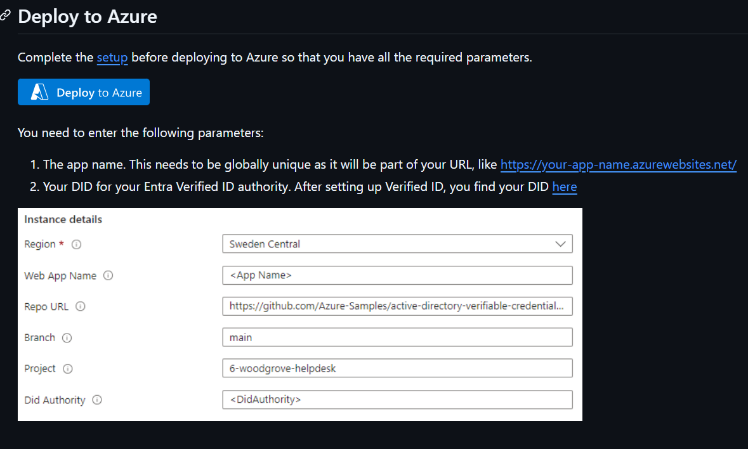
How to deploy and configure the sample?
Extending the sample with Microsoft Teams
The sample is prepared to send a message to a Microsoft Teams channel using a webhook. To extend the sample, create an incoming webhook and update the app's configuration in your Azure AppService's configuration:
Key | Value
AppSettings__UseTeamsWebhook | "true"
AppSettings__TeamsWebhookURL | URL of the incoming webhook

Slide 26
Let’s build this sample app together
Steps in documentation: https://aka.ms/verifiedhelpdesk

Slide 27
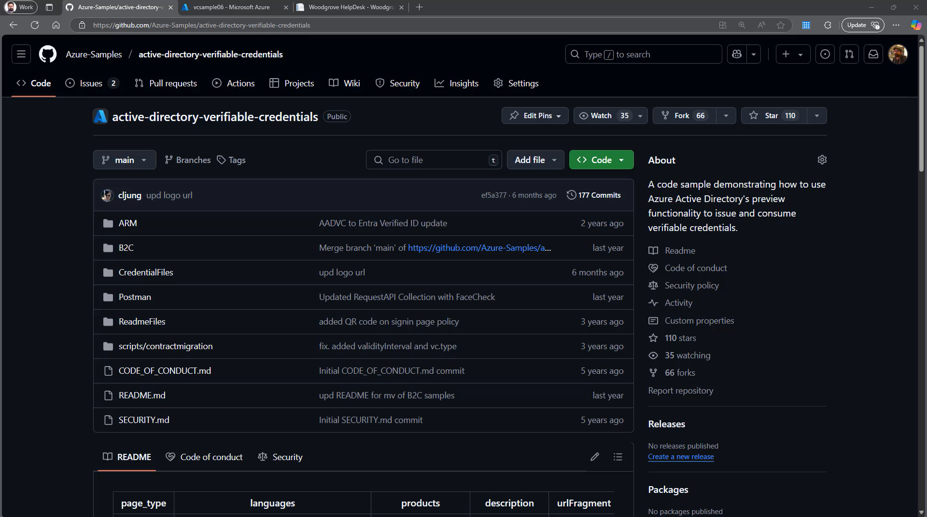

Slide 28
Learnings from POCs and FAQs
Feedback | Talking points
We don't' trust user photos in the Entra ID directory for VerifiedEmployee credential, as users can upload any photo they like. How will FaceCheck work in our case then? | You need a good quality photo in the base credential. For POC, you can control it with VerifiedEmployee but for production scenario, using IDV issued Verified IDs with good quality photo is recommended.
How do I add IDV partner integration in the scenario? | There are a set of IDV partners listed on https://aka.ms/verifiedisvgallery. Raise askentra request for direct IDV connections. There is a roadmap item for Entra in-product marketplace that will make this even simpler for configuration.

Slide 29
Learnings from POCs and FAQs
Feedback | Talking points
Are there any trial licenses available from IDV partners? | No, for demos using TrueIdentity integrated demo with https://aka.ms/vcdemo and Use VerifiedEmployee from Microsoft corp network https://myaccount.microsoft.com with https://aka.ms/facecheckdemo
How do I integrate such verification patterns with my ticketing tools like ServiceNow, BMC Remedy etc. | Refer https://aka.ms/verifiedhelpdesk and Entra Suite webinar Securing Helpdesk with Verified ID webinar
Can I use this pattern with my IVR Helpdesk solution as well? | Yes, with software based IVR solution, you could use Verified ID APIs for such patterns.

Slide 30

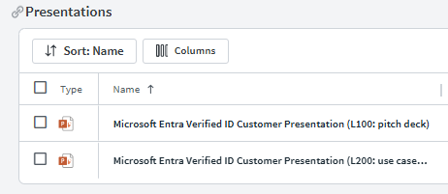
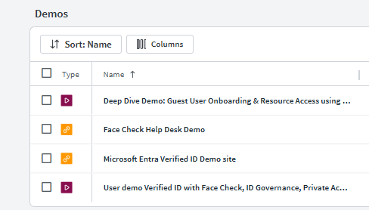
Resources
Customer deck for presentation at https://aka.ms/verifiedidfield Demo sites Employee Onboarding https://aka.ms/vcdemo Helpdesk demo https://aka.ms/facecheckdemo PoC in a box deck with demos/recordings

Slide 31

Call to Action
Learn more
https://aka.ms/verifiedidfield
Protect Privileged users with Face Check immediately using Free Trial for Entra Suite
Learn more about Face Check with Microsoft Entra Verified ID
1
Face Check General Availability Blog
Reduce time and complexity for employees and vendor facing helpdesk services using Entra ID
Discover more Verified ID use cases
2
Microsoft Entra Verified ID eBook
Learn more about Microsoft Entra Verified ID
Pick a use case and do a quick PoC – refer to Ebook for inspiration
Microsoft Entra Verified ID Webpage
3
Discover more Verified ID use cases
Microsoft Entra Verified ID eBook
Find Verified ID developer tools
Microsoft Entra Verified ID Documentation

Slide 32
Appendix

Slide 33



Scenarios for Workforce
Hiring
At Work
Alumni
Identity verification
Workplace credentials / employee ID
Benefits onboarding
Access
Annual Benefits
Employee Discounts
Business to Business
Business to Contractor
IT helpdesk support
Last Day at Employer
Alumni Benefits
Proof of Employment
List of Certifications
Notes:
Remote Onboarding + B2B collab + high assurance and recovery

Slide 34
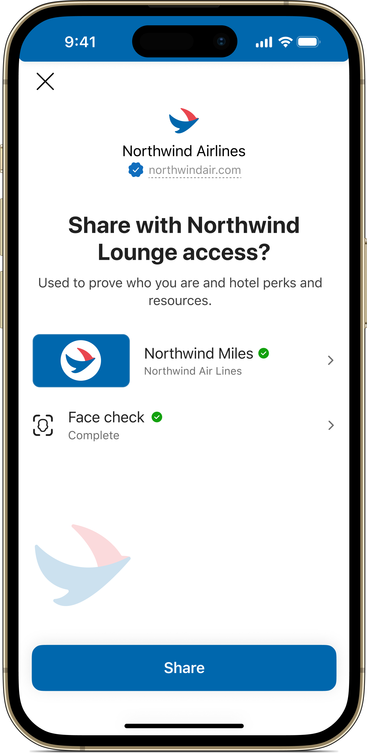
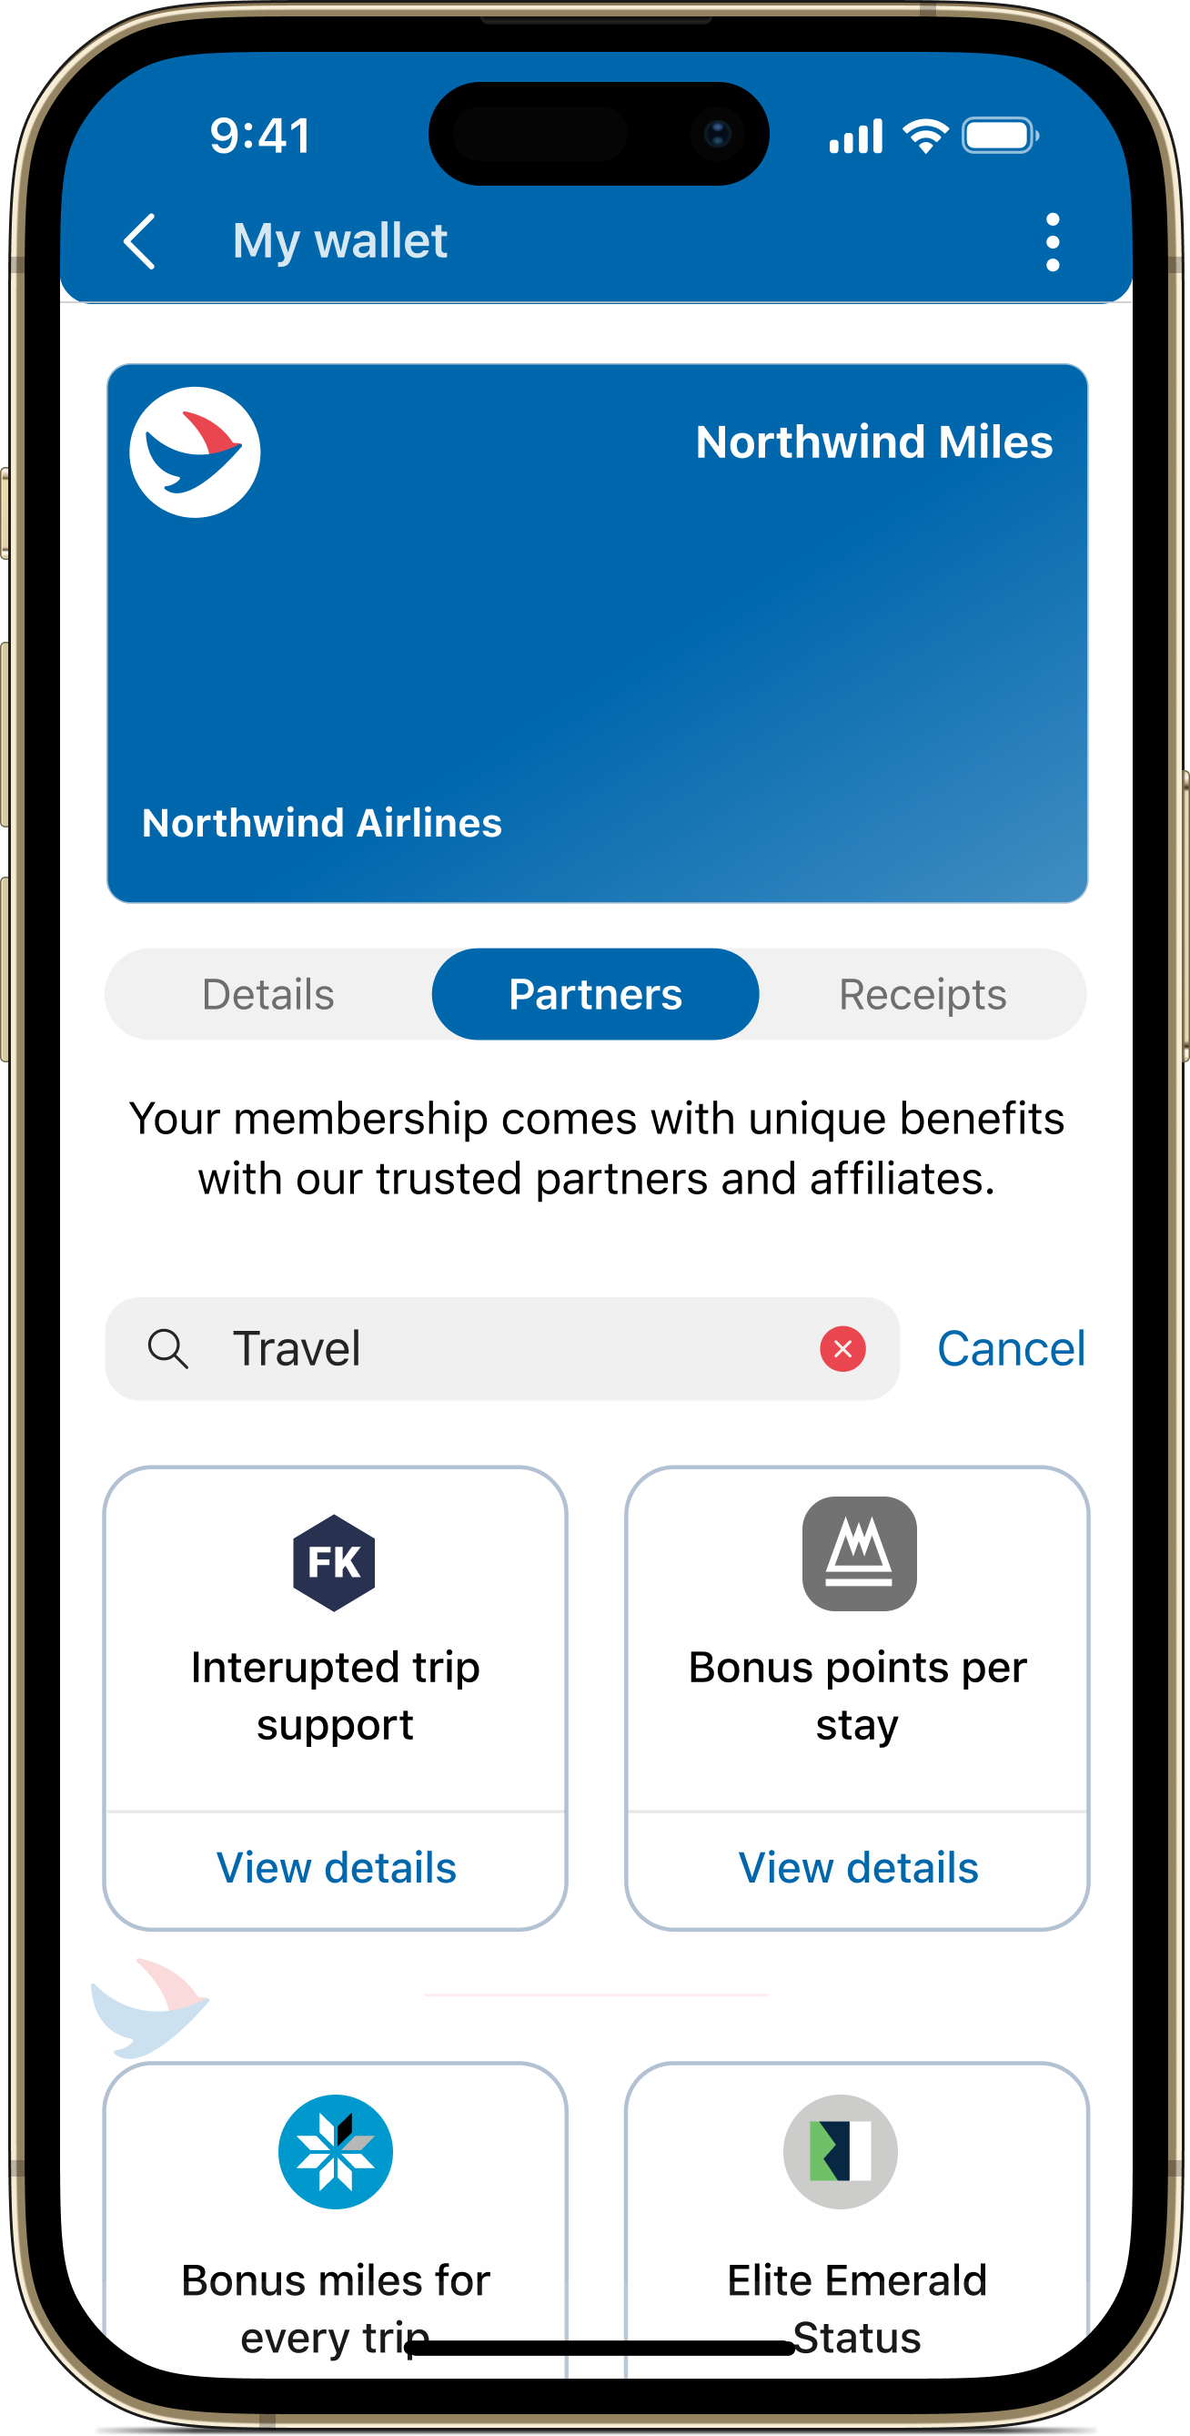
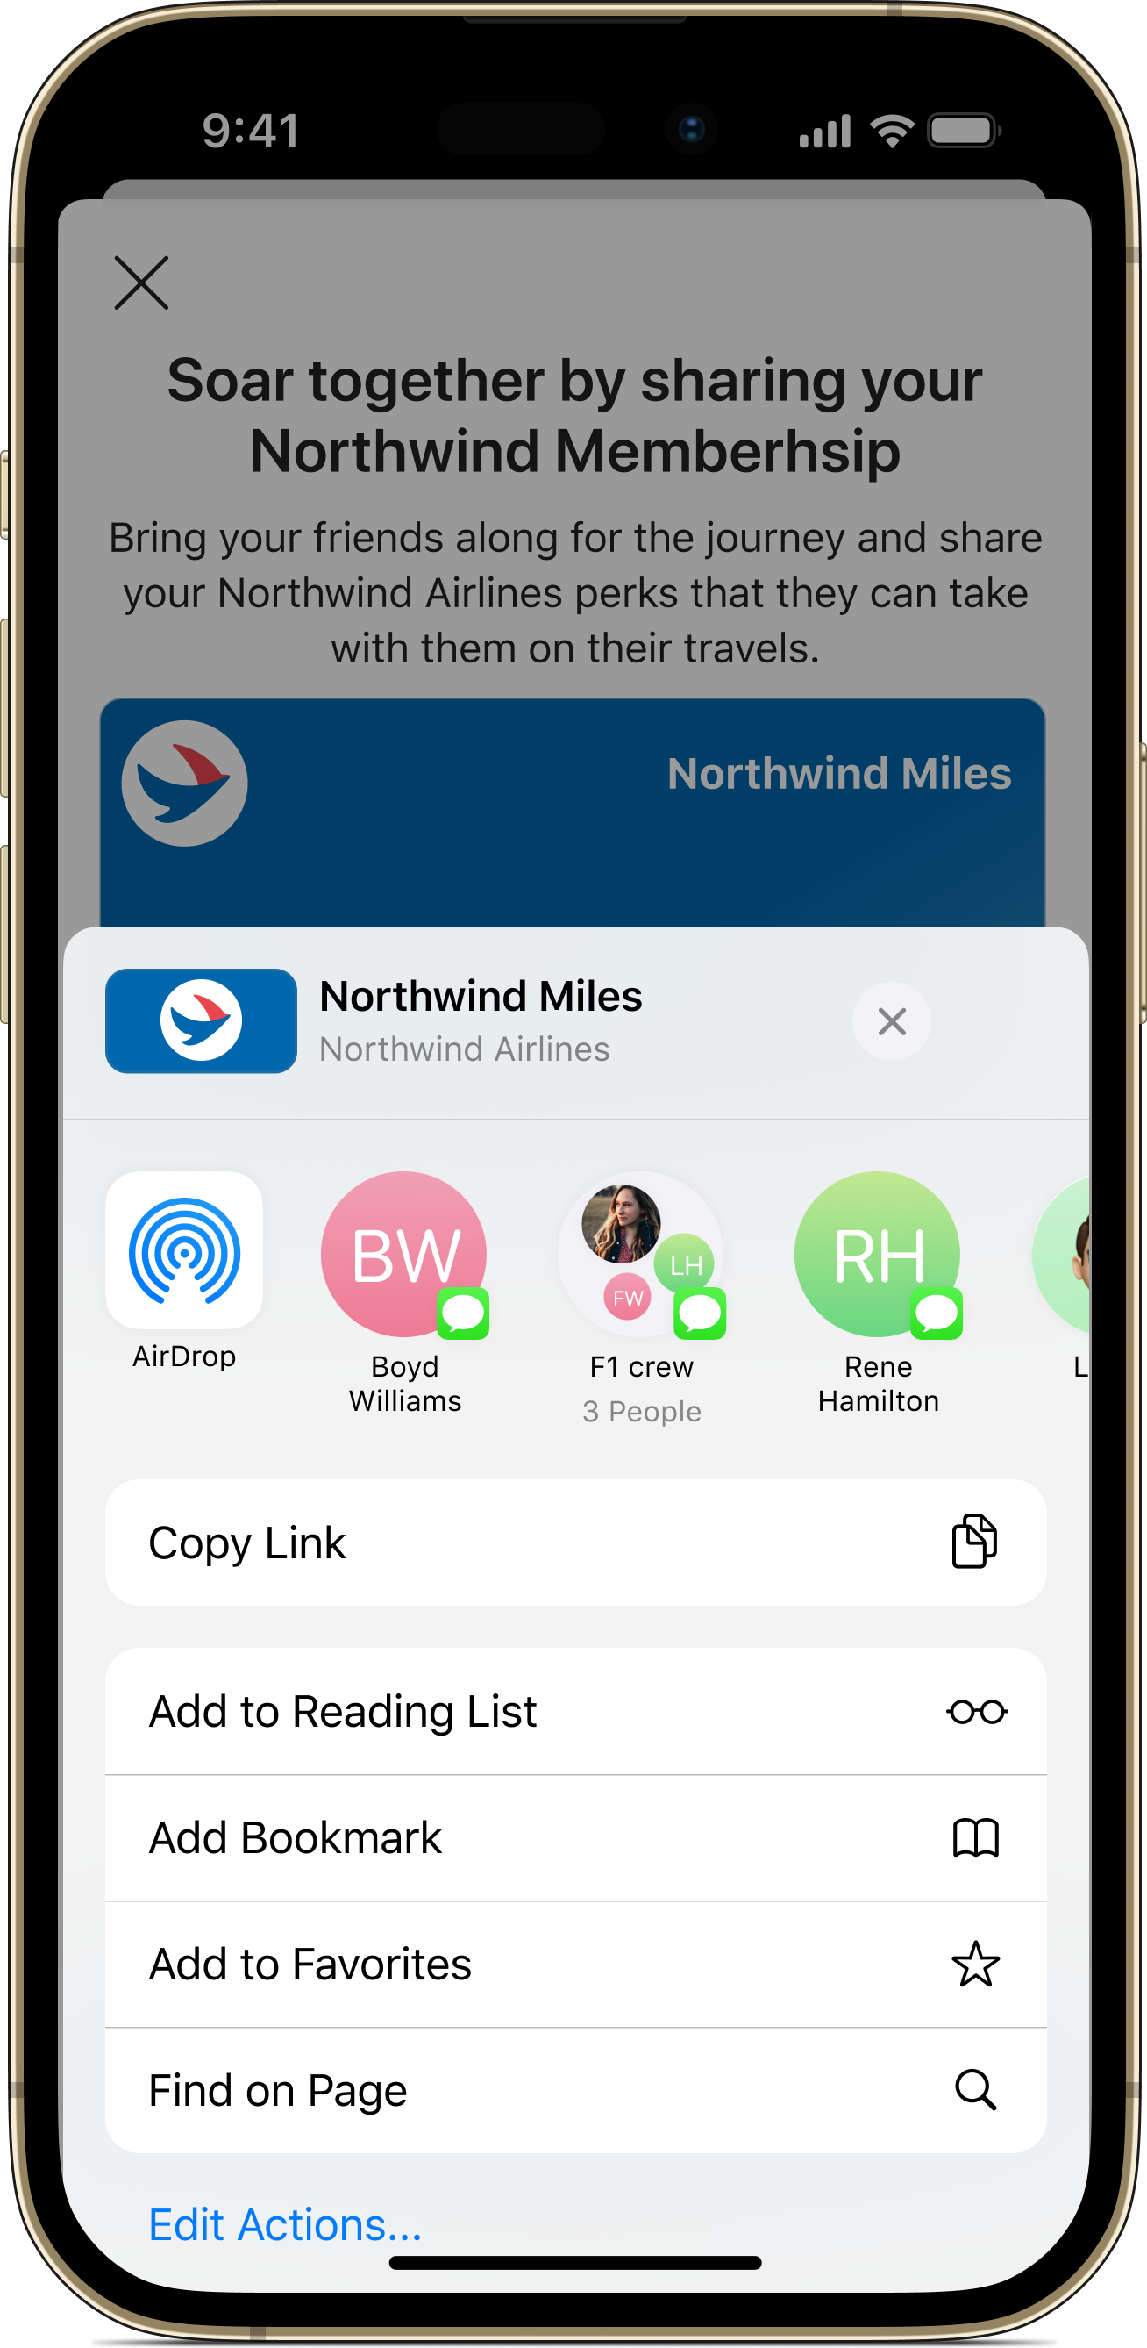
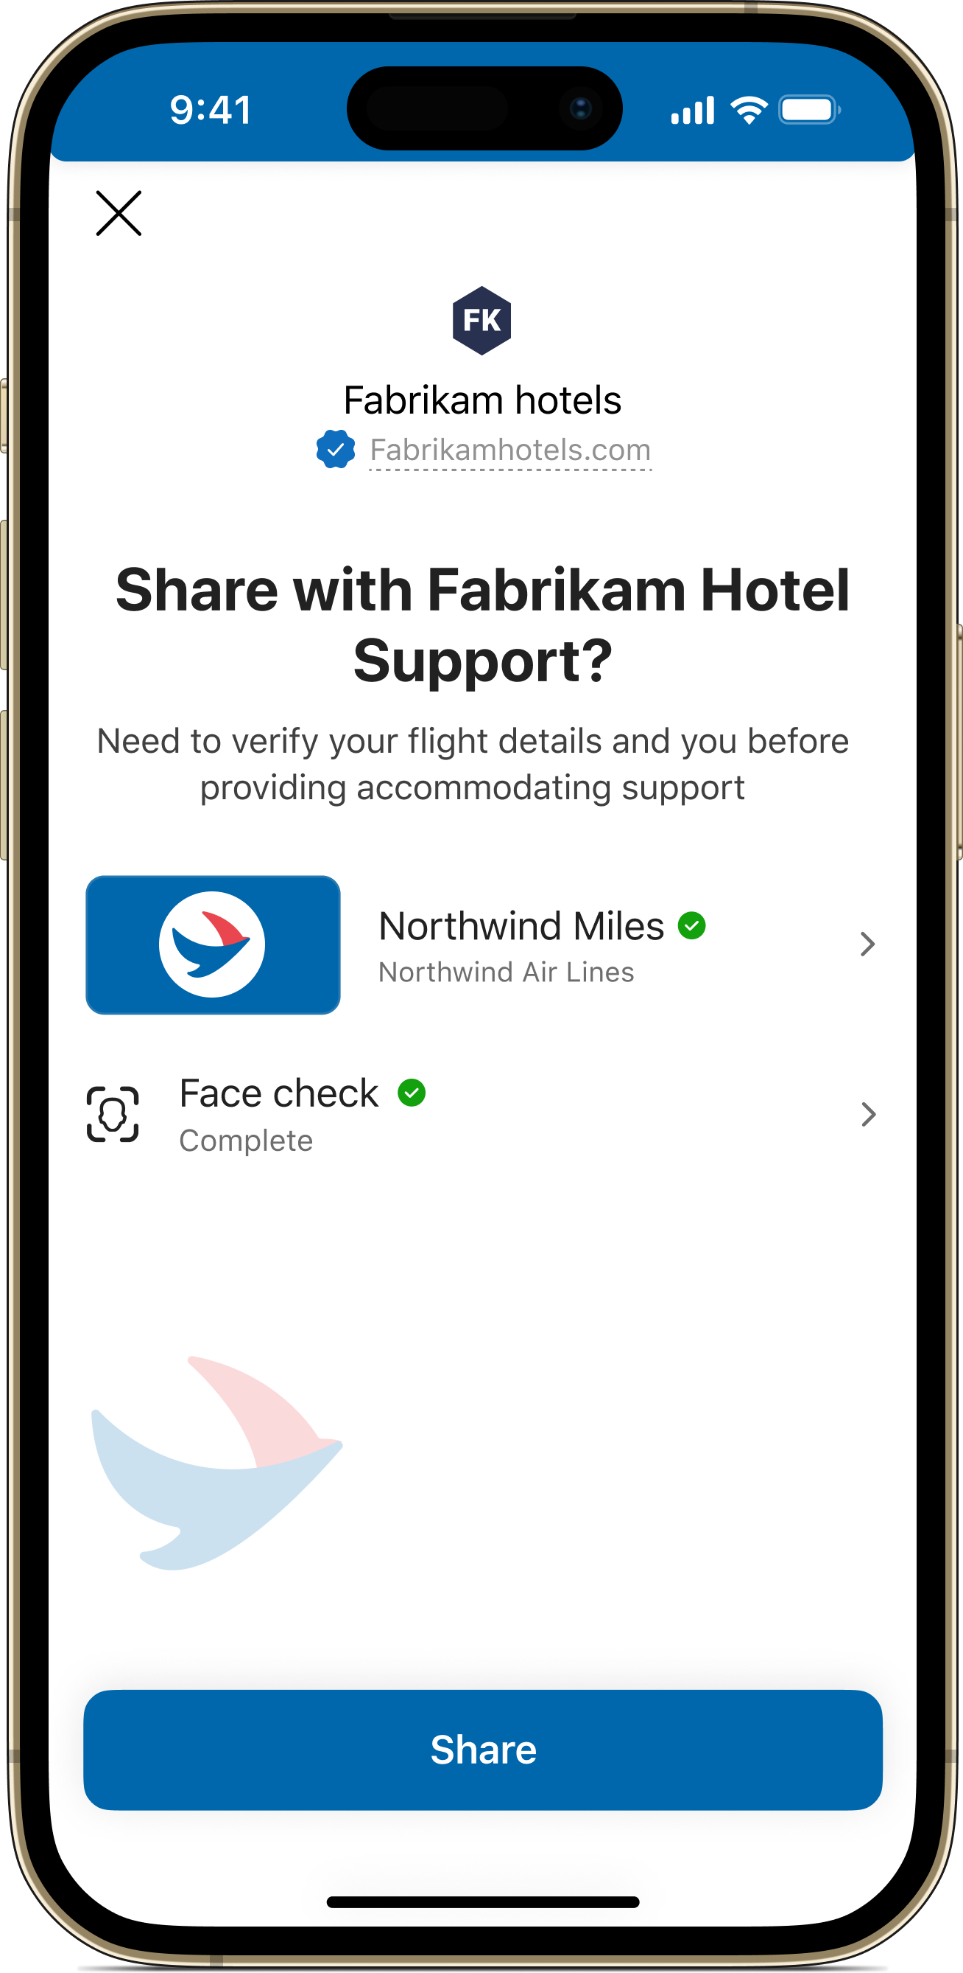
Scenarios for Consumers using External ID
Reduce fraud and account takeover (online & in-person)
Improve experience with affiliates
Streamline referral experience
Reduce Helpdesk costs

Slide 35
Success Criteria for a POC
Scenario | Tasks | Success Criteria
Assign employee access to resources (new or move scenario) | Entitlement Management Verified ID Private Access | Configure the end to end scenario Create an access package that shows VID in policy, assignment of resources and a set of user assignments (2-3)
Secure onboarding for guests/contractors and resource access | Entitlement Management Verified ID | Create an access package that shows policy targeted for guests, VID in policy, assignment of resources and a set of user assignments (2-3)
Secure privileged access (verify privileged users) | Entitlement Management Verified ID | Create 1 access package with Entra roles as resources and a set of user assignments (2-3)
Helpdesk and account recovery | Verified ID GitHub sample | Configure GitHub sample. Show a set of users (2-3) getting issued VerifiedEmployee, successful verifications and Teams webhook
Notes:
Secure onboarding for guests/contractors and resource access
Entitlement Management
Verified ID
Secure privileged access (verify privileged users)
Entitlement Management
Verified ID
Helpdesk and account recovery
Verified ID
GitHub sample

Slide 36
Your scenario(s) Storyboards
Notes:
Talking points added to key slides

Slide 37
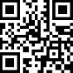
Health Records - Issuing Card
To
From
Subject
Alice Smith
someone
Keeping and presenting your health records is a scan away
Healthcare Provider Portal
Authenticator
Obtain your health records powered by OneDID by scanning this QR code in Authenticator
Welcome to CA Healthcare Provider
We partner with OneDID so you can now obtain a Verified OneDID card containing your health records directly onto your phone. Use your card in more than 20,000 medical institutions nation wide.
.
Add to Authenticator
Username
Password
Get card
Sign in
Email
OneDID Agent Portal
Authenticator sign in
Authenticator
Authenticator
Authenticator
Alice Health Records
CA Healthcare Provider
Issued by OneDID
Information in this card
Alice Health Records
Card Receipts
Activity on this card
First: Alice
Allergies: none
Date: 01.01.21 – card issued
Last: Smith
Hearth conditions: none
Where can I use this?
Sign in to applications outside your company.
DOB: xx/xx/xxxx
Gender: F
Smokes: No
Blood Type: A+
Drinks: No
Height 5’9
Weight: xx.xk
Add card
Close
Close
Accept a card
Card details
Card receipts

Slide 38
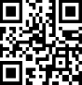


Health Records - Presenting and Verifying Card
intranet.floridahealthcare.net
Authenticator
Florida Healthcare Provider Intranet
Patient Registration
Card Status: valid
Provider OneDID/CA Healthcare
To access your health records for faster patience registrations
Patient registration
OneDID
Patient Details
Additional FL patient details
Alice Health Records
Healthcare Provider
Issued by OneDID
First: Alice
Allergies: none
Type of service: Emergency
Last: Smith
Hearth conditions: none
Status: ER Triage
DOB: xx/xx/xxxx
Florida Healthcare Provider Office
Gender: F
Smokes: No
Blood Type: A+
Drinks: No
Accept and Present
Height 5’9
Weight: xx.xk
Register Patient
Healthcare facility registration
Present Health records card
Patient registration at institution
intranet.floridahealthcare.net
To
From
Subject
Alice Smith
CA Healthcare providers
Provider visit
Florida Healthcare Internal System
Authenticator
Patient Details
Diagnostic
Card Receipts
First: Alice
Allergies: none
Procedure one: Hand inspection
Our records indicate that you visited Florida Healthcare provider on 02.01.21. You can access the records of your visit in our portal
.
Activity on this card
Last: Smith
Hearth conditions: none
Procedure two: x-ray right hand
Date: 01.01.21 – card issued
DOB: xx/xx/xxxx
Procedure two: x-ray right hand
Gender: F
Smokes: No
Date: 02.01.21 – Presented at FL healthcare provider
Blood Type: A+
Drinks: No
Go to Portal
Date: 02.01.21 – Healthcare records updated
Height 5’9
Treatment
Weight: xx.xk
Immobilization of finger follow up in 1-week
Patience Status: valid, active with
provider
Cost $xx,xxx.xx
Provider: CA Healthcare provider
File Claim
Close
Healthcare service details claims
Transaction notification
Alice VC card receipt

Slide 39
Thank you.

